Slide 1
Note to Instructors
The slides in this PPT file cover two sections:
Nand to Tetris, Part II: A short introduction / overview to the second part of the book / course (chapters 7-12), in which we build the software hierarchy
Chapter 7, Virtual Machine, Part I
We normally cover both sections in the same lecture.

Slide 2
Nand to Tetris, Part II
These slides support
the introductory section “Part II” of the book

Slide 3
Usage Notice
You are welcome to use this presentation, or any part of it, in Nand to Tetris courses, or in other courses, as you see fit.
Usage is free for instruction in educational, non-profit settings.
For permission to use the materials in other settings, contact schocken@gmail.com
You can use the slides as-is, or modify them as needed.
We’ll appreciate it if you will credit Nand to Tetris somewhere, and put a reference to www.nand2tetris.org
To stay in touch with our course team about updates and new teaching materials, fill in this form.
Happy teaching!
Shimon Schocken / Noam Nisan

Slide 4



Hello, World Below
Jack program
// First example in Programming 101
class Main {
function void main() {
do Output.printString("Hello World!");
do Output.println(); // New line
return;
}
}
Hello World!
Issues:
How does the program execute?
How does it handle do, while, ... etc.?
How does it write on the screen?
How are classes and methods realized?
How is function-call-and-return handled?
How is memory allocated to objects and arrays?
Add your questions to the list…
Q: How can high-level programmers ignore all these issues?
A: They treat the high-level program as an abstraction
What makes the abstraction work?
Assembler
Virtual machine
Compiler
Operating system
Projects 6-12

Slide 5
Nand to Tetris Roadmap
software hierarchy
human
abstraction
thought
program
high-level language
abstraction
compiler
VM code
abstraction
OS
VM translator
machine language
assembler
abstraction
hardware platform
computer
abstraction
computer
ALU, RAM
abstraction
chips
elementary logic gates
Nand
gates

Slide 6

Nand to Tetris Roadmap: Part I
software hierarchy
human
abstraction
thought
program
high-level language
abstraction
compiler
VM code
abstraction
OS
VM translator
machine language
assembler
abstraction
hardware platform
computer
abstraction
computer
ALU, RAM
abstraction
chips
elementary logic gates
Nand
gates

Slide 7
Nand to Tetris Roadmap: Part II
software hierarchy
human
abstraction
thought
program
high-level language
abstraction
compiler
VM code
abstraction
OS
VM translator
machine language
assembler
Part II: Building a software infrastructure that enables the compilation and execution of programs written in high-level languages
Our choice: Jack
A simple, Java-like, object-based language.

Slide 8
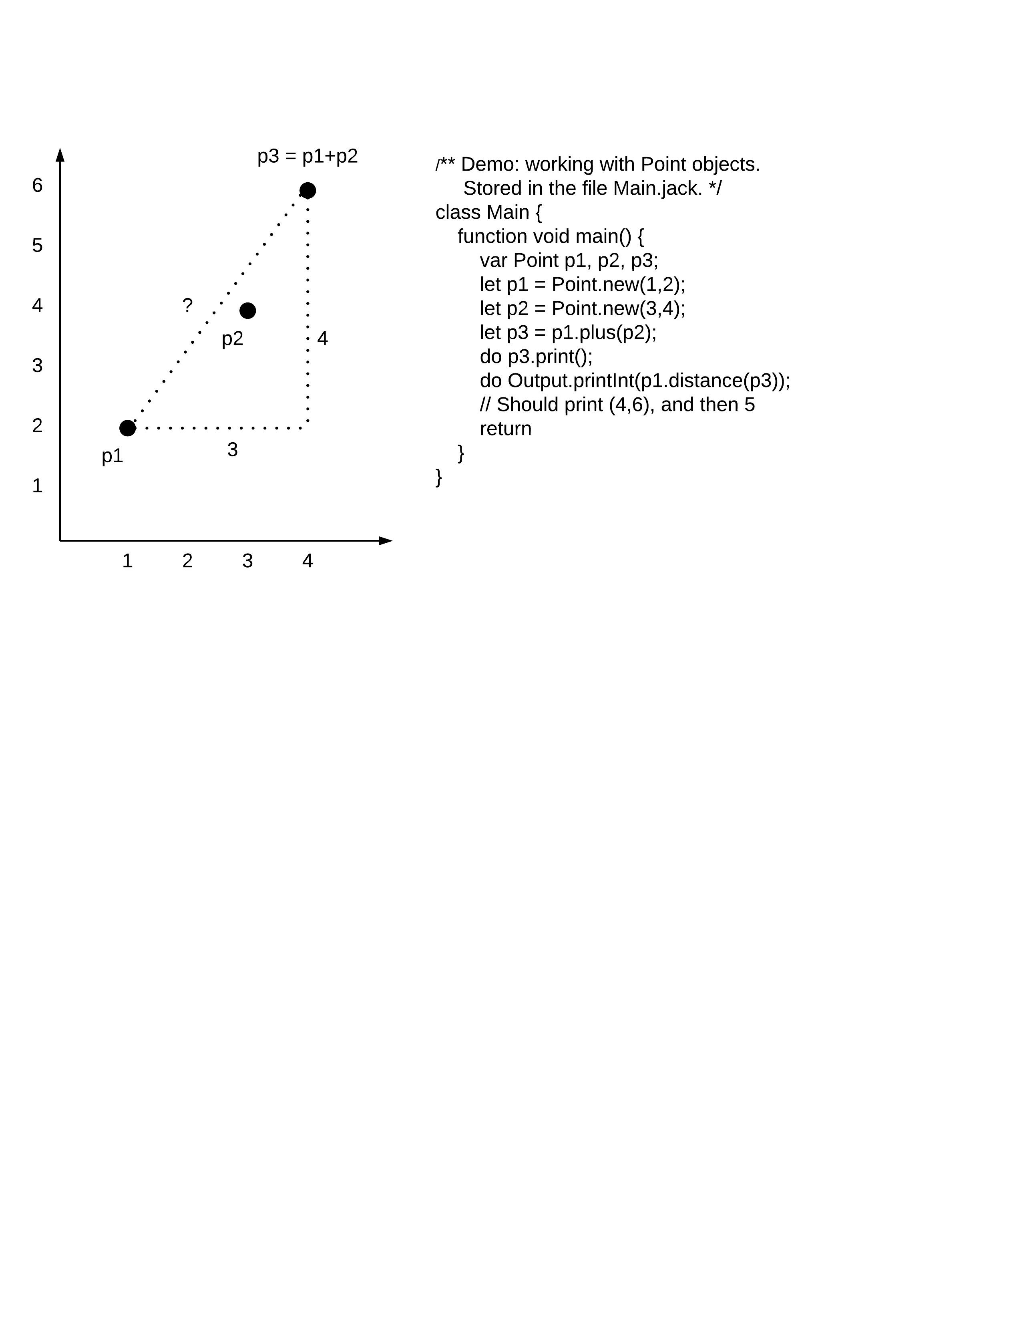
High-level language
Example: write a program that:
Constructs 2D points, like p1 and p2
Computes and prints p3 = p1 + p2
Computes and prints distance(p1,p3)
(Using a Point class/ type)
distance
A Point class:
Written in the Jack language
/** Represents a 2D point (API) */
class Point {
/** Constructs a new point with the given coordinates */
constructor Point new(int ax, int ay)
/** Returns the point which is this point plus the other point */
method Point plus(Point other)
/** Cartesian distance between this and the other point */
method int distance(Point other)
/** Prints this point as "(x,y)" */
method void print()
...
}
(4,6)
5

Slide 9
High-level language
/** Constructs and manipulates Point objects */
class Main {
function void main() {
var Point p1, p2, p3;
let p1 = Point.new(1,2);
let p2 = Point.new(3,4);
let p3 = p1.plus(p2);
do p3.print();
distance
Written in the Jack language
/** Represents a 2D point (API) */
class Point {
/** Constructs a new point with the given coordinates */
constructor Point new(int ax, int ay)
/** Returns the point which is this point plus the other point */
method Point plus(Point other)
/** Cartesian distance between this and the other point */
method int distance(Point other)
/** Prints this point as "(x,y)" */
method void print()
...
}
(4,6)
5

Slide 10
High-level language
/** Constructs and manipulates Point objects */
class Main {
function void main() {
var Point p1, p2, p3;
let p1 = Point.new(1,2);
let p2 = Point.new(3,4);
let p3 = p1.plus(p2);
do p3.print();
do Output.println();
do Output.printInt(p1.distance(p3));
return;
}
}
distance
Written in the Jack language
/** Represents a 2D point (API) */
class Point {
/** Constructs a new point with the given coordinates */
constructor Point new(int ax, int ay)
/** Returns the point which is this point plus the other point */
method Point plus(Point other)
/** Cartesian distance between this and the other point */
method int distance(Point other)
/** Prints this point as "(x,y)" */
method void print()
...
}
(4,6)
5
(4,6)
5

Slide 11
High-level language
/** Represents a 2D point.
File name: Point.jack. */
class Point {
// The coordinates of this point
field int x, y
// The number of Point objects constructed so far:
static int pointCount;
/** Constructs a two-dimensional point and
initializes it with the given coordinates. */
constructor Point new(int ax, int ay) {
let x = ax;
let y = ay;
let pointCount = pointCount + 1;
return this;
}
/** Returns the x coordinate of this point. */
method int getx() { return x; }
/** Returns the y coordinate of this point. */
method int gety() { return y; }
/** Returns the number of points constructed so far. */
function int getPointCount() {
return pointCount;
}
// Class declaration continues on top right.
For now, don’t worry about syntax and details
Just notice that Jack is a typical object-based, high-level language

Slide 12
High-level language
/** Represents a 2D point.
File name: Point.jack. */
class Point {
// The coordinates of this point
field int x, y
// The number of Point objects constructed so far:
static int pointCount;
/** Constructs a two-dimensional point and
initializes it with the given coordinates. */
constructor Point new(int ax, int ay) {
let x = ax;
let y = ay;
let pointCount = pointCount + 1;
return this;
}
/** Returns the x coordinate of this point. */
method int getx() { return x; }
/** Returns the y coordinate of this point. */
method int gety() { return y; }
/** Returns the number of points constructed so far. */
function int getPointCount() {
return pointCount;
}
// Class declaration continues on top right.
/** Returns a point which is this point plus the other point. */
method Point plus(Point other) {
return Point.new(x + other.getx(),
y + other.gety());
}
/** Returns the Euclidean distance between
this and the other point. */
method int distance(Point other) {
var int dx, dy;
let dx = x – other.getx();
let dy = y – other.gety();
return Math.sqrt((dx*dx) + (dy*dy));
}
/** Prints this point as "(x,y)" */
method void print() {
do Output.printString("(");
do Output.printInt(x);
do Output.printString(",");
do Output.printInt(y);
do Output.printString(")");
return;
}
} // End of Point class declaration.

Slide 13
Nand to Tetris Roadmap: Part II
software hierarchy
human
Writing a
abstraction
thought
program
high-level language
abstraction
compiler
VM code
abstraction
OS
VM translator
machine language
assembler
What does it take to implement such a language?

Slide 14
Nand to Tetris Roadmap: Part II
software hierarchy
human
Writing a
abstraction
thought
program
high-level language
abstraction
compiler
VM code
abstraction
OS
VM translator
machine language
assembler
Compilation model: 2-tier

Slide 15
Compilation
One tier:
“source code”
“executable code”
Program written in a high-level language
Machine level instructions
(bits)
compiler
Two tier:
“source code”
“abstract code”
“executable code”
Program written in a high-level language
VM commands
(Bytecode)
Machine level instructions
(bits)
compiler
VM translator

Slide 16

Compilation
One tier:
“source code”
“executable code”
Program written in a high-level language
Machine level instructions
(bits)
compiler
Pros:
1-tier compilers generate efficient, target-specific code
Cons:
Requires multiple compilers / compilations, one for each target hardware platform.

Slide 17


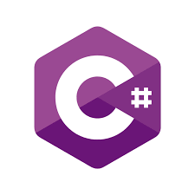
Compilation
Two tier:
“source code”
“abstract code”
“executable code”
Program written in a high-level language
VM commands
(Bytecode)
Machine level instructions
(bits)
compiler
VM translator
Pros:
Compile once, run everywhere
Cons:
Requires multiple VM translators, one for each target hardware platform
(But: VM translators are much simpler than compilers)
Generates less efficient machine language code
(But: For numerous apps, the inefficiency delta is insignificant).

Slide 18
Compilation
Program folder
(named points)
Program folder
(named points)
points.asm
points.hack
Main.jack
Main.vm
...
M=D
@i
M=0
(LOOP)
@i
D=M
@n
D=D-M
@END
D;JGT
@addr
...
...
1101010010101011
1100001101010101
0101010011101100
1100101111111111
0101110101010011
1100111111010101
0101110110101011
1100100000001011
0101110111100010
1111000111010100
0010101000101011
0111000111010111
1010101000101011
...
class Main
function void main {
var Point p1;
...
}
}
...
push local 1
push const 3
add
...
compiler
VM translator
assembler
Point.jack
Point.vm
class Point
field int x,y;
...
}
...
push arg 2
call Math.sqrt
...
load
(4,6)
5

Slide 19
Nand to Tetris Roadmap: Part II
p9
software hierarchy
human
Writing a
abstraction
p10
p11
thought
program
high-level language
Building a
abstraction
p7
p8
compiler
VM code
Building a
abstraction
OS
VM translator
machine language
p12
Part II chapters / projects:
assembler
7, 8: building the compiler’s backend (virtual machine)
9: writing a computer game
10, 11: developing the compiler’s frontend
12: developing an operating system.

Slide 20
Chapter 7
Virtual Machine
(Part I)

Slide 21
Usage Notice
You are welcome to use this presentation, or any part of it, in Nand to Tetris courses, or in other courses, as you see fit.
Usage is free for instruction in educational, non-profit settings.
For permission to use the materials in other settings, contact schocken@gmail.com
You can use the slides as-is, or modify them as needed.
We’ll appreciate it if you will credit Nand to Tetris somewhere, and put a reference to www.nand2tetris.org
To stay in touch with our course team about updates and new teaching materials, fill in this form.
Happy teaching!
Shimon Schocken / Noam Nisan

Slide 22
Virtual Machine I: Lecture plan
Overview
VM Language: Abstraction
VM Language: Implementation
VM Emulator
Standard Mapping
VM Translator
Project 7
Perspective

Slide 23
Nand to Tetris Roadmap: Part II
software hierarchy
human
abstraction
thought
program
high-level language
abstraction
compiler
VM code
abstraction
OS
VM translator
machine language
assembler

Slide 24
Nand to Tetris Roadmap: Part II
software hierarchy
human
abstraction
thought
program
high-level language
abstraction
compiler
VM code
abstraction
OS
VM translator
machine language
Lecture / chapter 7 goals:
Understanding the VM abstraction (VM code)
Building a VM implementation (VM translator)
assembler
Key theme: The VM code that the compiler generates is designed to operate on an abstract stack machine.

Slide 25

Stack
top
Basic operations:
push: adds an element at the stack’s top
pop: removes the top element

Slide 26
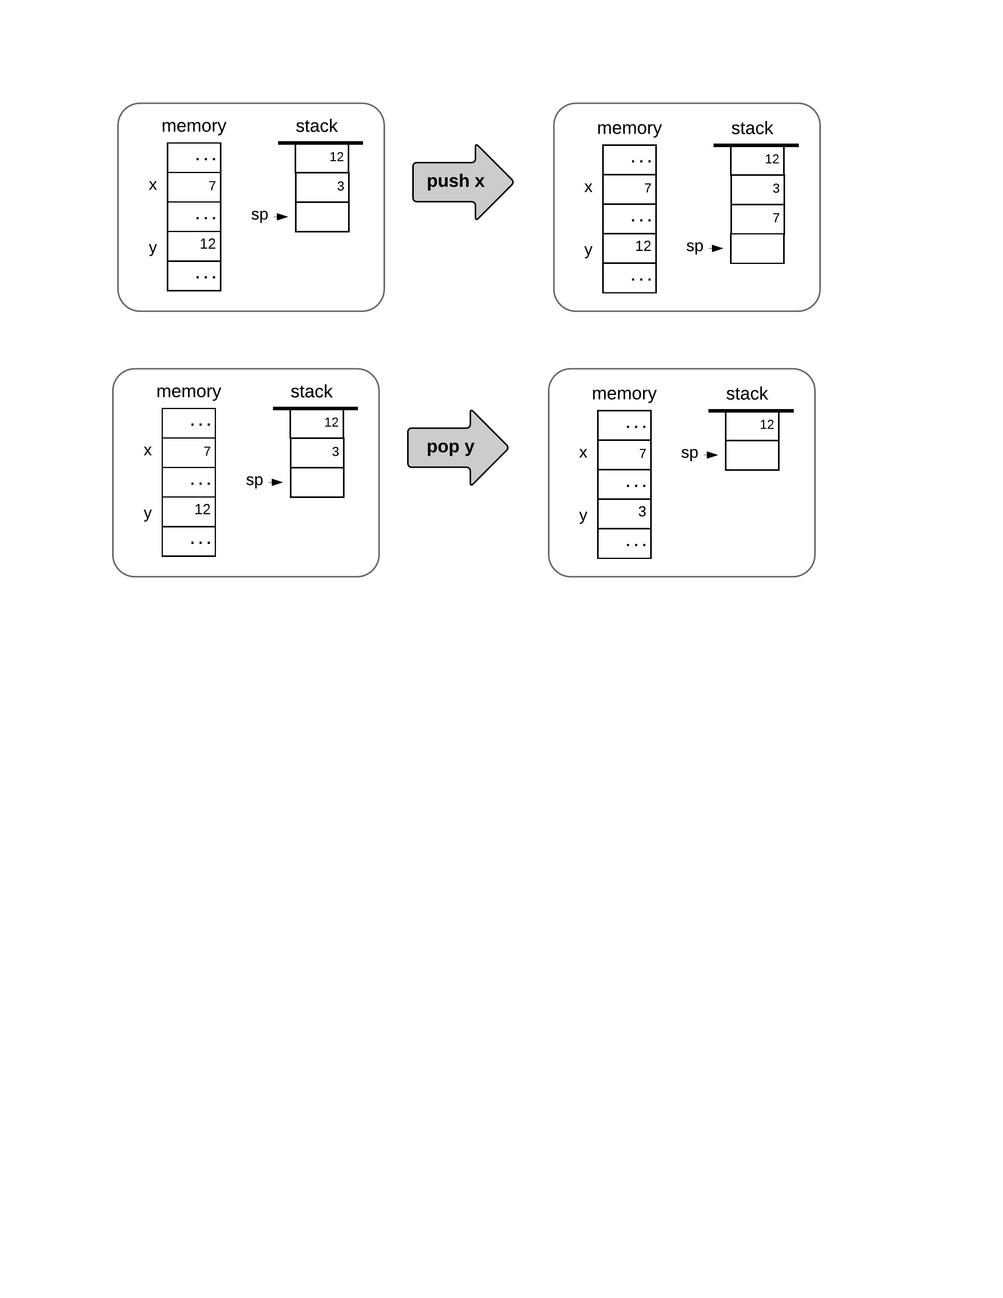
Stack

Slide 27
Stack

Slide 28
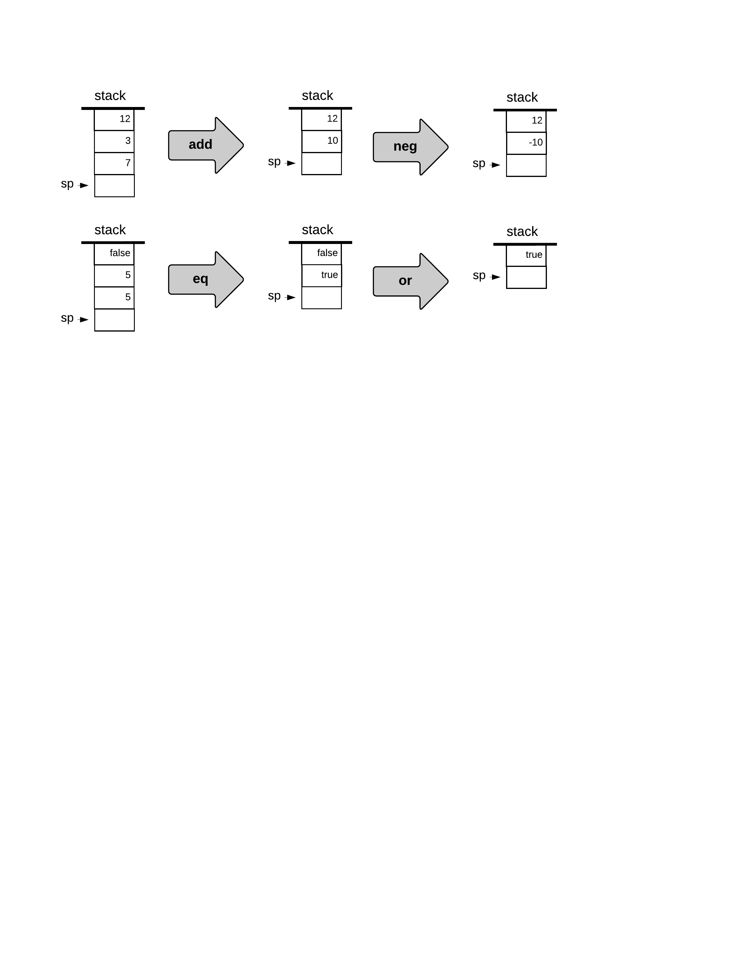
Stack arithmetic

Slide 29
Stack arithmetic

Slide 30
Stack arithmetic

Slide 31
Stack arithmetic
Applying a function f (that has n arguments):
pops n values (arguments) from the stack,
Computes f on the values,
Pushes the resulting value onto the stack.

Slide 32
Stack arithmetic
Applying a function f (that has n arguments):
pops n values (arguments) from the stack,
Computes f on the values,
Pushes the resulting value onto the stack.

Slide 33
Stack arithmetic
Applying a function f (that has n arguments):
pops n values (arguments) from the stack,
Computes f on the values,
Pushes the resulting value onto the stack.

Slide 34
Stack arithmetic
Applying a function f (that has n arguments):
pops n values (arguments) from the stack,
Computes f on the values,
Pushes the resulting value onto the stack.

Slide 35
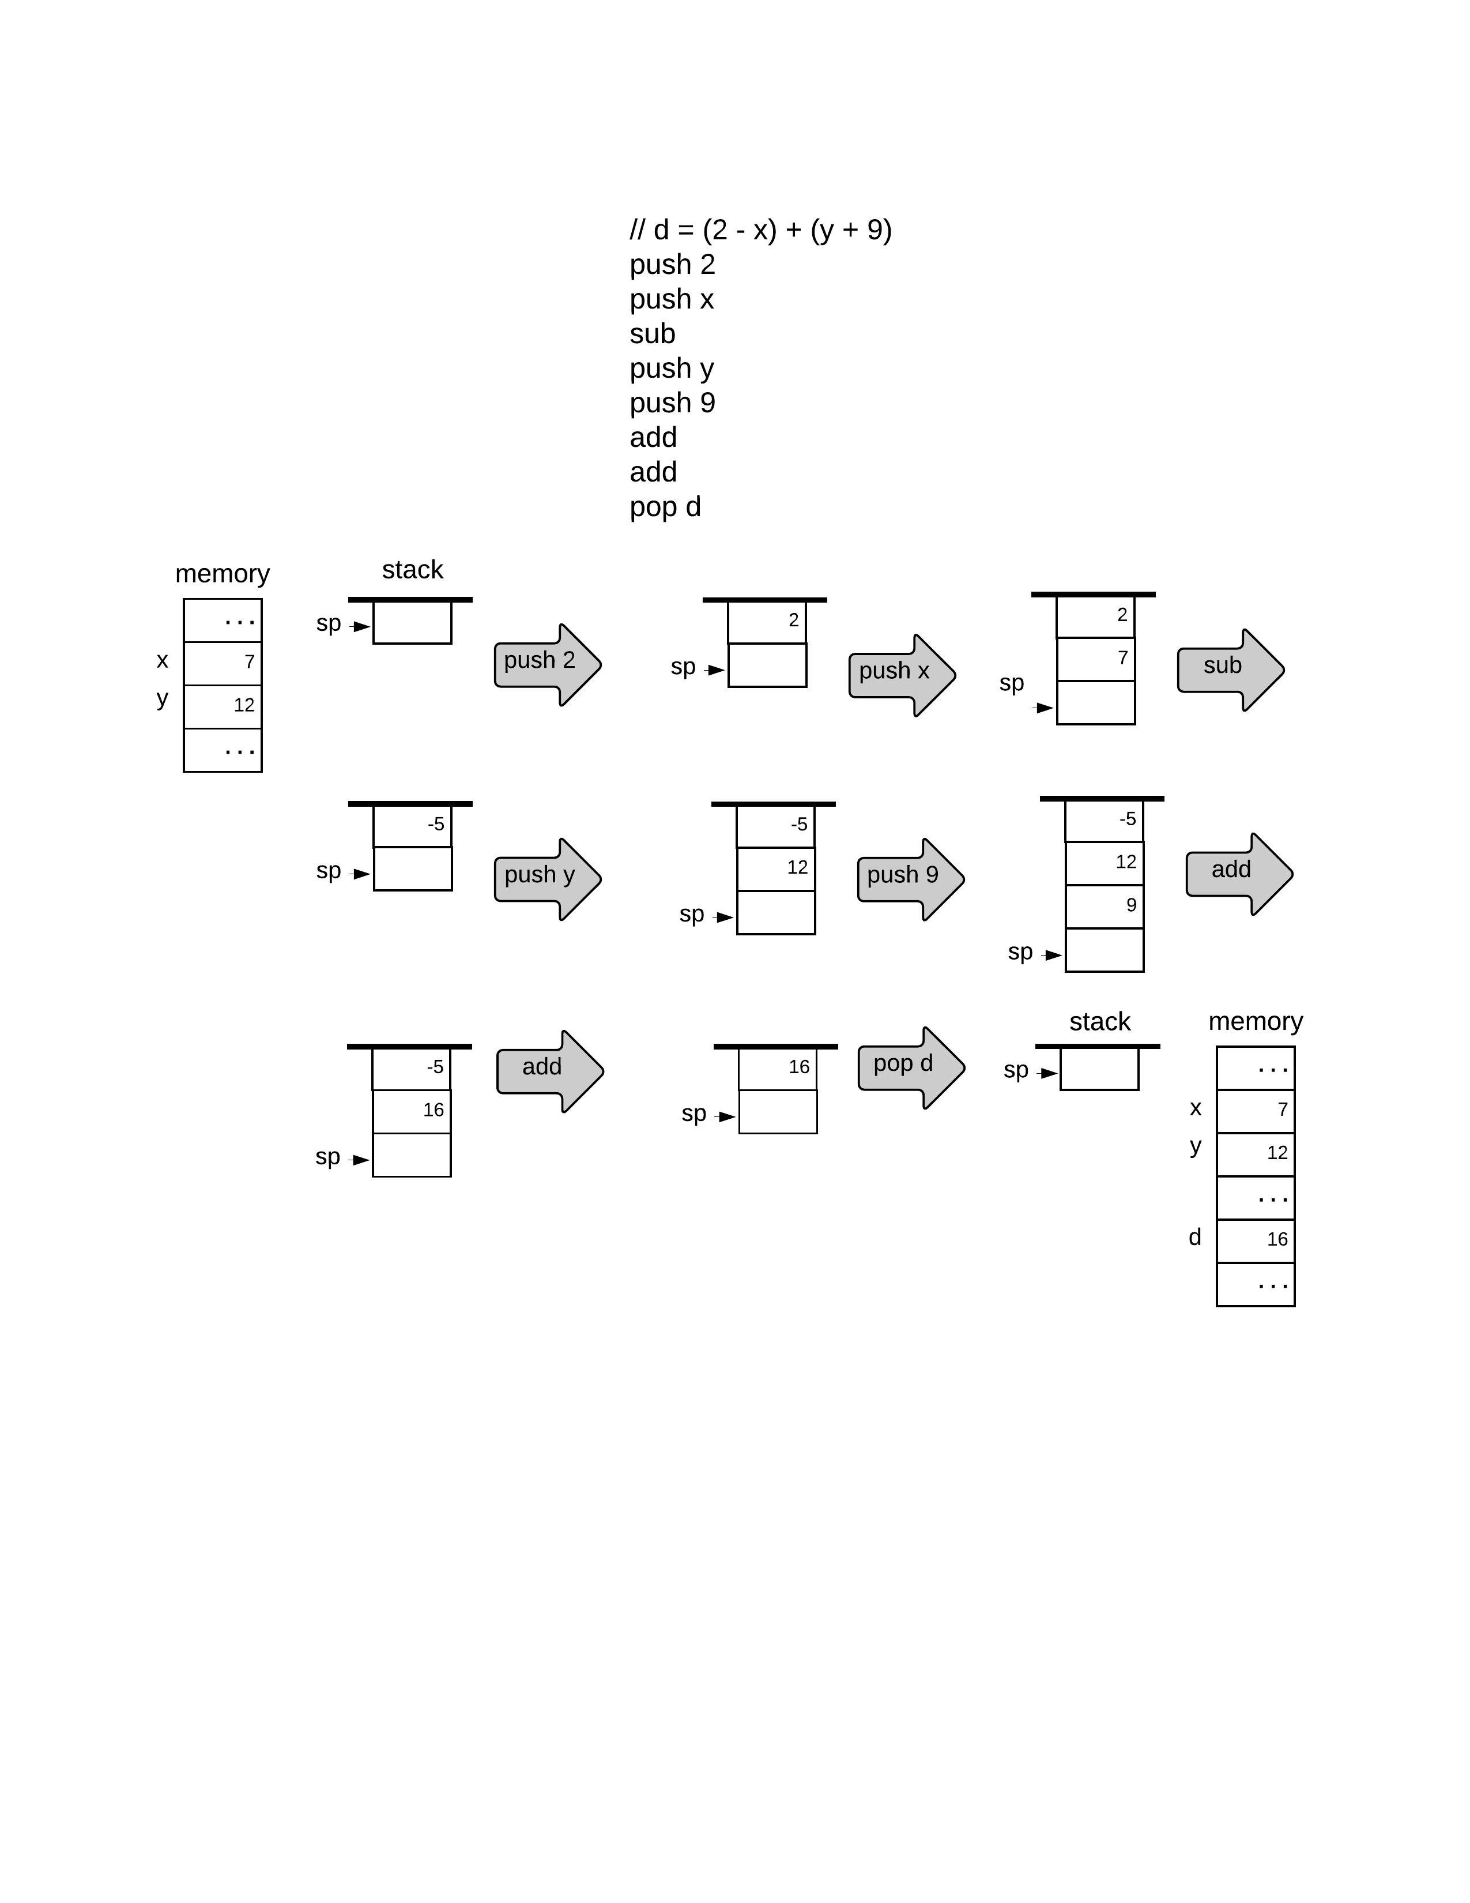
Arithmetic commands
VM code (example)
// d = (2 – x) + (y + 9)

Slide 36
Arithmetic commands
VM code (example)
// d = (2 – x) + (y + 9)
push 2
push x
sub
push y
push 9
add
add
pop d

Slide 37
Arithmetic commands
VM code (example)
// d = (2 – x) + (y + 9)
push 2
push x
sub
push y
push 9
add
add
pop d

Slide 38
Arithmetic commands
VM code (example)
// d = (2 – x) + (y + 9)
push 2
push x
sub
push y
push 9
add
add
pop d

Slide 39
Arithmetic commands
VM code (example)
// d = (2 – x) + (y + 9)
push 2
push x
sub
push y
push 9
add
add
pop d

Slide 40
Arithmetic commands
VM code (example)
// d = (2 – x) + (y + 9)
push 2
push x
sub
push y
push 9
add
add
pop d

Slide 41
Arithmetic commands
VM code (example)
// d = (2 – x) + (y + 9)
push 2
push x
sub
push y
push 9
add
add
pop d

Slide 42
Arithmetic commands
VM code
VM code (example)
// d = (2 – x) + (y + 9)
push 2
push x
sub
push y
push 9
add
add
pop d

Slide 43
Arithmetic commands
VM code (example)
// d = (2 – x) + (y + 9)
push 2
push x
sub
push y
push 9
add
add
pop d

Slide 44
Arithmetic commands
VM code (example)
// d = (2 – x) + (y + 9)
push 2
push x
sub
push y
push 9
add
add
pop d

Slide 45
Arithmetic commands
VM code (example)
// d = (2 – x) + (y + 9)
push 2
push x
sub
push y
push 9
add
add
pop d

Slide 46
Arithmetic commands
VM code (example)
// d = (2 – x) + (y + 9)
push 2
push x
sub
push y
push 9
add
add
pop d

Slide 47
Arithmetic commands
VM code (example)
// d = (2 – x) + (y + 9)
push 2
push x
sub
push y
push 9
add
add
pop d

Slide 48
Arithmetic commands
VM code (example)
// d = (2 – x) + (y + 9)
push 2
push x
sub
push y
push 9
add
add
pop d
21

Slide 49
Arithmetic commands
VM code (example)
// d = (2 – x) + (y + 9)
push 2
push x
sub
push y
push 9
add
add
pop d
21

Slide 50
Arithmetic commands
VM code (example)
// d = (2 – x) + (y + 9)
push 2
push x
sub
push y
push 9
add
add
pop d
21

Slide 51
Arithmetic commands
VM code (example)
// d = (2 – x) + (y + 9)
push 2
push x
sub
push y
push 9
add
add
pop d
21

Slide 52
Arithmetic commands
VM code (example)
// d = (2 – x) + (y + 9)
push 2
push x
sub
push y
push 9
add
add
pop d
21

Slide 53
Arithmetic commands
VM code (example)
// d = (2 – x) + (y + 9)
push 2
push x
sub
push y
push 9
add
add
pop d
21

Slide 54
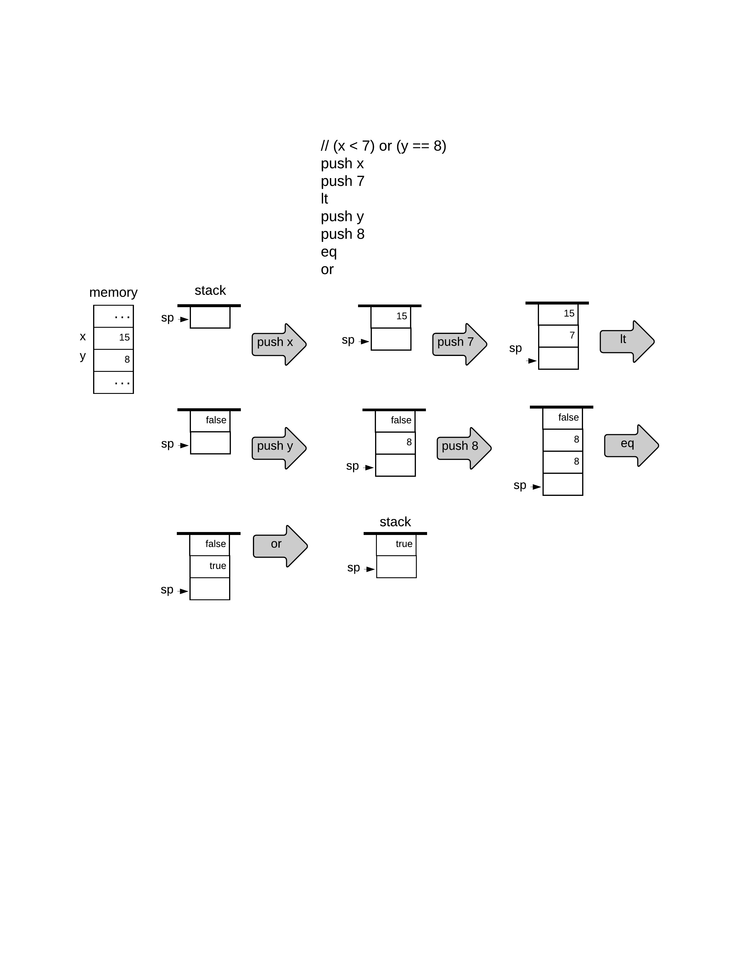
Logical commands
VM code (example)
// (x < 7) or (y == 8)

Slide 55
Logical commands
VM code (example)
// (x < 7) or (y == 8)
push x
push 7
lt
push y
push 8
eq
or

Slide 56
Logical commands
VM code (example)
// (x < 7) or (y == 8)
push x
push 7
lt
push y
push 8
eq
or

Slide 57
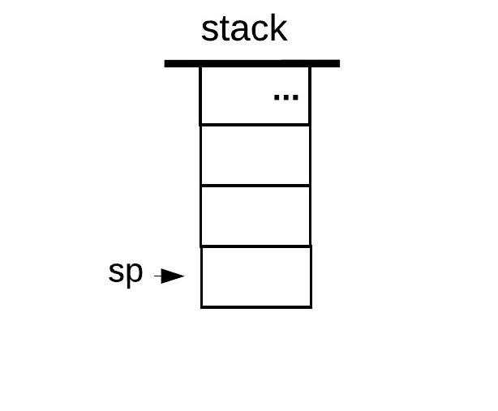
Arithmetic / Logical VM commands
Command | Return value | Return value
add | x + y | integer
sub | x – y | integer
neg | –y | integer
eq | x == y | boolean
gt | x > y | boolean
lt | x < y | boolean
and | x And y | boolean
or | x Or y | boolean
not | Not x | boolean
x
y
The big picture: Compilation
VM code is typically written by compilers
Every high-level arithmetic-logical expression can be translated into a sequence of operations on a stack, using these VM commands.

Slide 58
Virtual Machine I: Lecture plan
Overview
VM Language: Abstraction
VM Language: Implementation
VM Emulator
Standard Mapping
VM Translator
Project 7
Perspective

Slide 59

The VM language (abstraction)
Push / pop commands
push segment i
pop segment i
Arithmetic / Logical commands
add, sub , neg
eq , gt , lt
and, or , not
Branching commands
label label
goto label
if-goto label
Function commands
Function functionName nVars
Call functionName nArgs
return
This lecture
Next lecture

Slide 60
The big picture: Compilation
Source code (Jack)
Compiled VM code
class Foo {
static int s1, s2;
function int bar (int x, int y) {
var int a, b, c;
...
let c = s1 + y;
...
}
}
...
...
...
...
...
...
...
...
...
compiler

Slide 61
The big picture: Compilation
Source code (Jack)
Compiled VM code
class Foo {
static int s1, s2;
function int bar (int x, int y) {
var int a, b, c;
...
let c = s1 + y;
...
}
}
...
...
...
...
push s1
push y
add
pop c
...
compiler
Two-tier compilation: The compiler translates each high-level statement into a sequence of VM commands
Arithmetic-logical operators like +, –, <, ==, … are translated into the VM arithmetic-logical commands add, sub, lt, eq, …
References to high-level variables are translated into push / pop commands.

Slide 62
The big picture: Compilation
Source code (Jack)
Compiled VM code
class Foo {
static int s1, s2;
function int bar (int x, int y) {
var int a, b, c;
...
let c = s1 + y;
...
}
}
...
...
...
...
push s1
push y
add
pop c
...
compiler
Each variable has a kind:
local, static, argument, field
The variable kinds must be represented also at the VM level

Slide 63
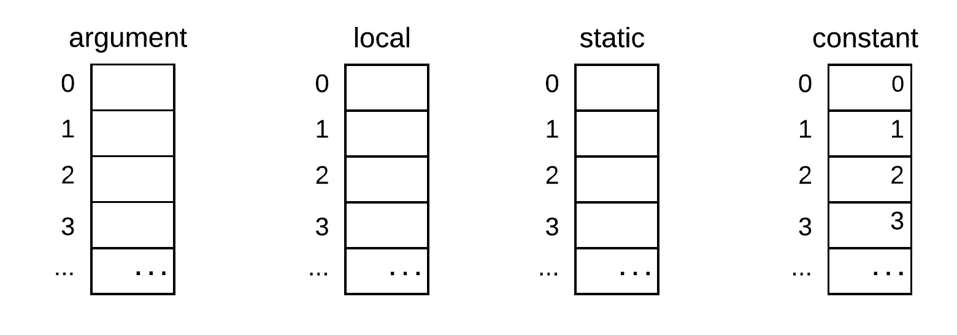
The big picture: Compilation
Source code (Jack)
Compiled VM code
class Foo {
static int s1, s2;
function int bar (int x, int y) {
var int a, b, c;
...
let c = s1 + y;
...
}
}
...
...
...
...
push s1
push y
add
pop c
...
compiler
Each variable has a kind:
local, static, argument, field
Abstract memory segments
The variable kinds must be represented also at the VM level
This is done using VM-level abstract memory segments

Slide 64
The big picture: Compilation
Source code (Jack)
Compiled VM code
class Foo {
static int s1, s2;
function int bar (int x, int y) {
var int a, b, c;
...
let c = s1 + y;
...
}
}
...
...
...
...
push static 0
push argument 1
add
pop local 2
...
compiler
Abstract memory segments
The compiler maps high-level symbolic variable names on abstract memory segment entries
The compiler translates each reference to a symbolic variable in the high-level code into a VM command of the form push / pop segment index
x
a
s1
y
b
s2
c

Slide 65
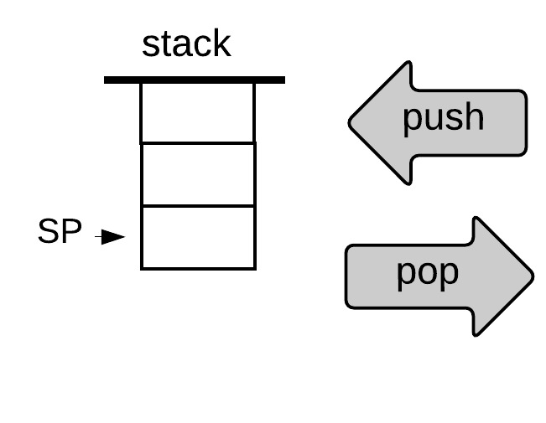
Memory segments
stack
memory
segments
push
0
0
1
local
argument
static
constant
pop
1
2
2
...
...
Example:
Suppose you want to set static 2 to argument 3 + 17
// static 2 ← argument 3 + 17
push argument 3
push constant 17
add
pop static 2

Slide 66
Memory segments
stack
memory
segments
push
0
0
local
argument
static
constant
this
that
pointer
temp
1
pop
1
2
2
...
...
Altogether, our VM model features 8 memory segments, whose roles will be described in the next lecture

Slide 67
Memory segments
stack
memory
segments
push
0
0
local
argument
static
constant
this
that
pointer
temp
1
pop
1
2
2
...
...
Altogether, our VM model features 8 memory segments, whose roles will be described in the next lecture
All segments are accessed using the same syntax:
push / pop segment i
where segment is local, argument, static, constant, this, that, pointer, or temp, and i is a non-negative integer.

Slide 68
The VM language: Abstraction
Push / pop commands
push segment i
pop segment i
Arithmetic / Logical commands
add, sub , neg
eq , gt , lt
and, or , not
Branching commands
label label
goto label
if-goto label
Function commands
Function functionName nVars
Call functionName nArgs
return
This lecture
Next lecture

Slide 69
The VM language: Abstraction
Push / pop commands
push segment i
pop segment i
Arithmetic / Logical commands
add, sub , neg
eq , gt , lt
and, or , not
Branching commands
label label
goto label
if-goto label
Function commands
Function functionName nVars
Call functionName nArgs
return
This lecture
Next lecture

Slide 70
Virtual Machine I: Lecture plan
Overview
VM Language: Abstraction
VM Language: Implementation
VM Emulator
Standard Mapping
VM Translator
Project 7
Perspective

Slide 71
The VM language: Implementation
Push / pop commands
push segment i
pop segment i
Arithmetic / Logical commands
add, sub , neg
eq , gt , lt
and, or , not
Branching commands
label label
goto label
if-goto label
Function commands
Function functionName nVars
Call functionName nArgs
return
How can we make this language “work”?
One option: Develop a VM translator
VM translator: A program that translates VM commands into machine language instructions

Slide 72
The VM language: Implementation
Push / pop commands
push segment i
pop segment i
Arithmetic / Logical commands
add, sub , neg
eq , gt , lt
and, or , not
Branching commands
label label
goto label
if-goto label
Function commands
Function functionName nVars
Call functionName nArgs
return
How can we make this language “work”?
One option: Develop a VM translator
VM translator: A program that translates VM commands into machine language instructions
Next task: Think how to implement each VM command in assembly

Slide 73
The VM language: Implementation
Push / pop commands
push segment i
pop segment i
Arithmetic / Logical commands
add, sub , neg
eq , gt , lt
and, or , not
Branching commands
label label
goto label
if-goto label
Function commands
Function functionName nVars
Call functionName nArgs
return
How can we make this language “work”?
One option: Develop a VM translator
VM translator: A program that translates VM commands into machine language instructions
Next task: Think how to implement each VM command in assembly

Slide 74
Implementing push / pop commands
stack
8 memory
segments
push
0
local
argument
this
that
constant
static
pointer
temp
0
1
pop
1
2
2
...
...

Slide 75
Implementing push / pop commands
stack
8 memory
segments
push
0
local
argument
this
that
constant
static
pointer
temp
0
1
pop
1
2
2
...
...

Slide 76
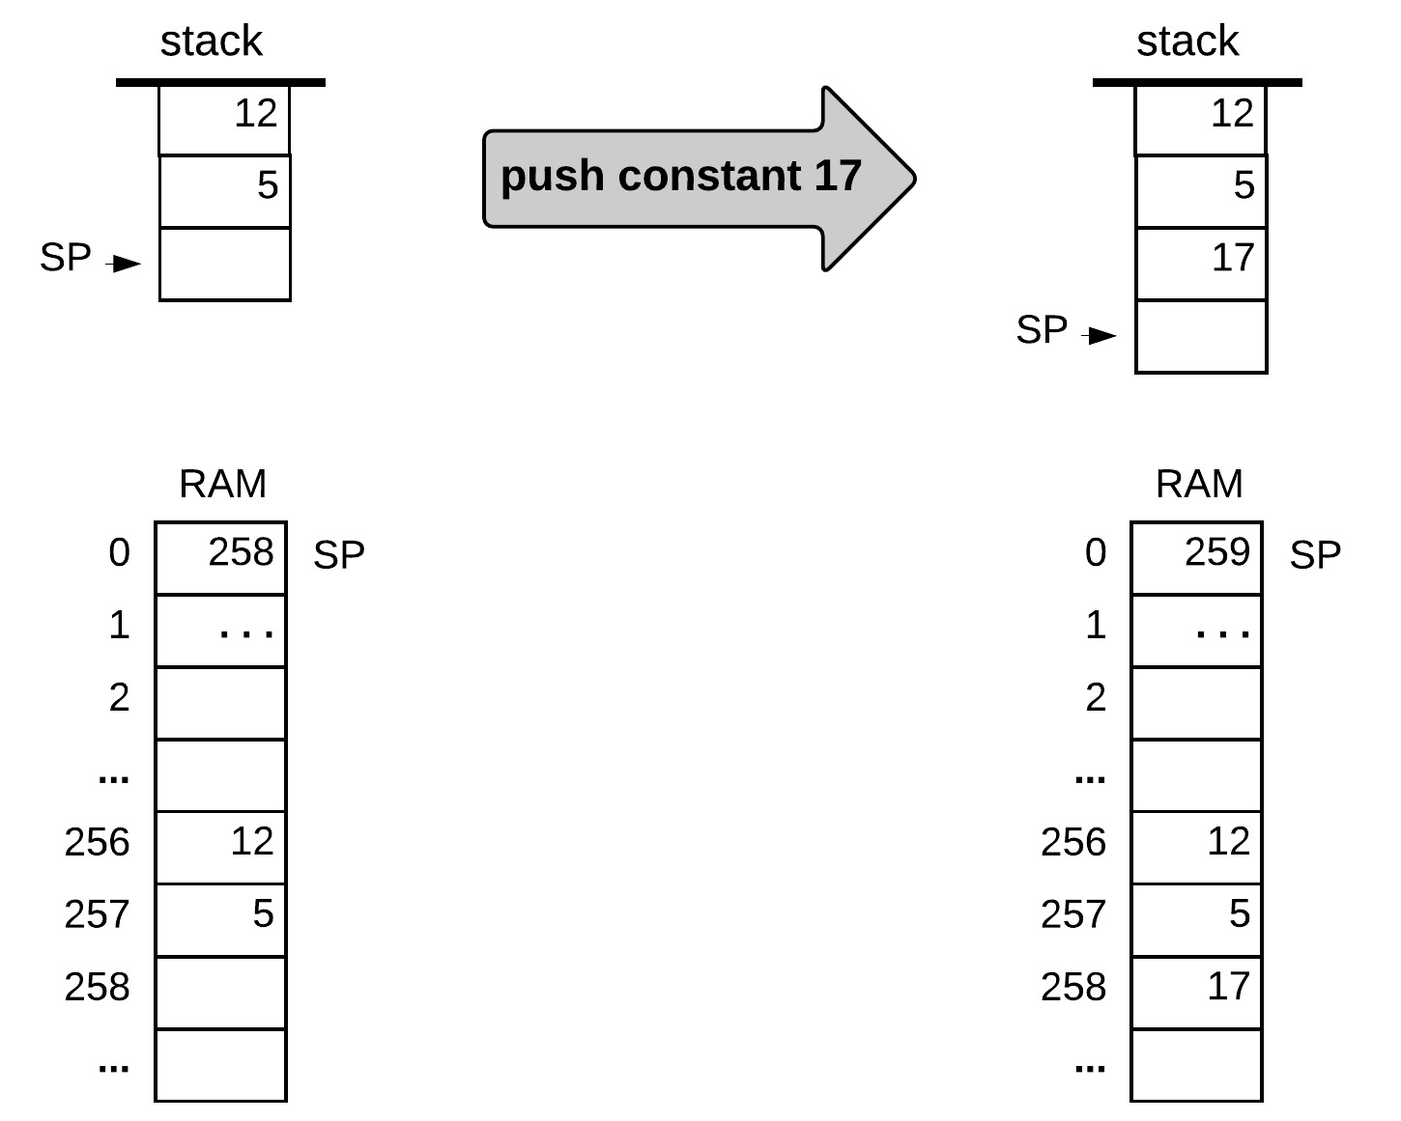
Implementing push constant i
Abstraction:
push constant 17
(example values)
push constant 17
(before) (after)

Slide 77
Implementing push constant i
Abstraction:
push constant 17
(example values)
Pseudocode
// push constant 17
RAM[SP] = 17
SP++
Implementation:
The stack is stored in the RAM, from address 256 onward
The stack pointer is stored in RAM[0]
push constant 17
(before) (after)

Slide 78
Implementing push constant i
Abstraction:
push constant 17
(example values)
Pseudocode
// push constant 17
RAM[SP] = 17
SP++
Implementation:
The stack is stored in the RAM, from address 256 onward
The stack pointer is stored in RAM[0]
Hack assembly
@17 // D =17
D=A
@SP // RAM[SP]=D
A=M
M=D
@SP // SP++
M=M+1
(before) (after)

Slide 79
Implementing push constant i
Abstraction
Implementation (general solution)
VM code
VM translator
Assembly code
push constant i
// push constant i
// D = i
@i
D=A
// RAM[SP]=D
@SP
A=M
M=D
// SP++
@SP
M=M+1
Notes
constant is not a “real segment”
Used for VM syntax consistency
There is no pop constant i command.

Slide 80
Implementing push / pop commands
stack
8 memory
segments
push
0
local
argument
this
that
constant
static
pointer
temp
0
1
pop
1
2
2
...
...

Slide 81
Implementing push/pop local i
stack
8 memory
segments
push
0
local
argument
this
that
constant
static
pointer
temp
0
1
pop
1
2
2
...
...
Abstraction: push/pop local i
Implementation:
The big picture: When the compiler translates a high-level method, it allocates a RAM block for representing the method’s local variables
At the VM level, this block is referred to as a virtual memory segment named local
The base address of the local segment is kept in a pointer named LCL
To access local i, access RAM[LCL + i] .

Slide 82
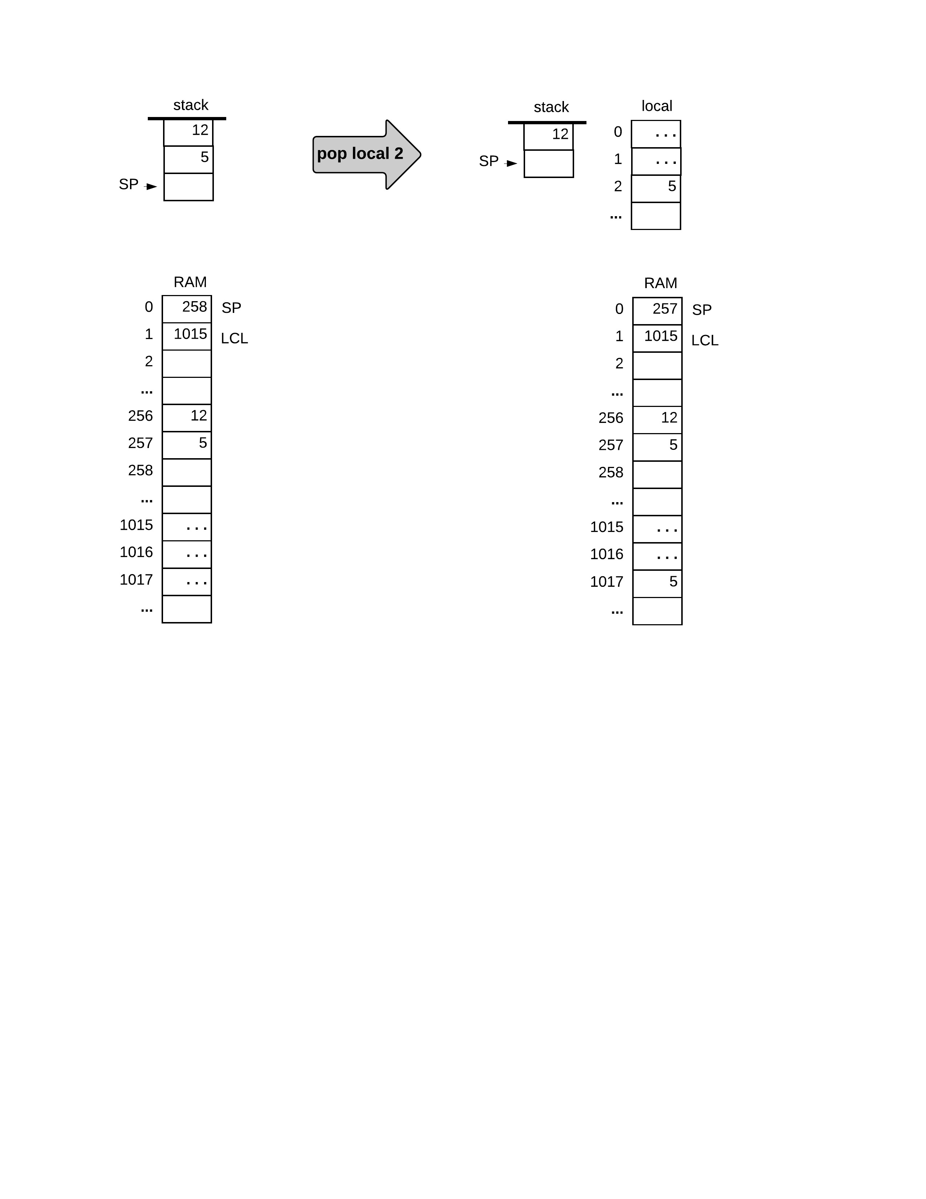
Implementing push/pop local i
131
pop local i
Abstraction:
131
19
i
...
i
19
(example values)
131
19
...
1015 + i
19

Slide 83
Implementing push/pop local i
131
pop local i
Abstraction:
131
19
i
...
i
19
(example values)
Implementation:
pop local i
The local segment is allocated to a RAM block
Here, the block’s base address happens to be 1015 (arbitrary example)
The base address of the local segment is kept in LCL
131
131
19
19
...
1015 + i
19

Slide 84
Implementing push/pop local i
131
pop local i
Abstraction:
131
19
i
...
i
19
(example values)
Pseudocode
Implementation:
// pop local i
addr ← LCL + i
SP--
RAM[addr] ← RAM[SP]
The local segment is allocated to a RAM block
Here, the block’s base address happens to be 1015 (arbitrary example)
The base address of the local segment is kept in LCL
131
131
19
Hack assembly:
19
You figure it out!
...
1015 + i
19

Slide 85
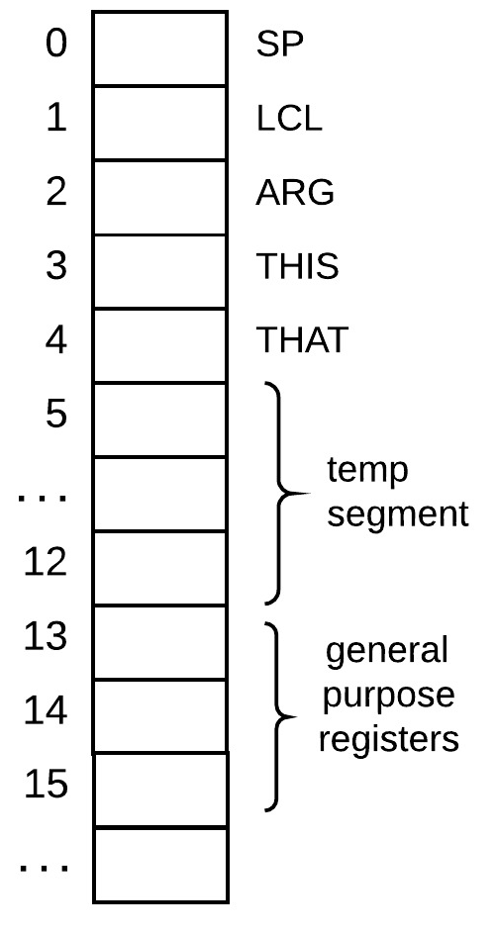
Implementing push/pop local i
Assembly pseudo code:
Host RAM
VM code:
pop local i
VM translator
// pop local i
addr ← LCL + i
SP--
RAM[addr] ← RAM[SP]
VM translator
// push local i
addr ← LCL + i
RAM[SP] ← RAM[addr]
SP++
push local i
The big picture:
When the compiler compiles a high-level method, it represents…
the method’s local variables in the virtual segment local
the method’s arguments in the virtual segment argument
the fields of the current object in the virtual segment this
the entries of the current array in the virtual segment that
Implemented the same way at the VM level

Slide 86
Implementing push/pop {local | argument | this | that} i
Assembly pseudo code:
Host RAM
VM code:
pop local i
VM translator
// pop local i
addr ← LCL + i
SP--
RAM[addr] ← RAM[SP]
VM translator
// push local i
addr ← LCL + i
RAM[SP] ← RAM[addr]
SP++
push local i
To access segment i where segment is local, argument, this, that:
access RAM[segmentPointer + i]
where segmentPointer is LCL, ARG, THIS, THAT

Slide 87
Implementing push / pop commands
stack
8 memory segments
push
0
local
argument
this
that
constant
static
pointer
temp
0
1
pop
1
2
2
...
...

Slide 88
Implementing push/pop static i
stack
8 memory segments
push
0
local
argument
this
that
constant
static
pointer
temp
0
1
pop
1
2
2
...
...
The Big Picture
A Jack program is a collection of one or more Jack classes
Each class is a separate compilation unit
A “class file” Foo.jack is compiled into a “VM file” named Foo.vm
The compiler maps the class-level static variables on the VM segment static

Slide 89
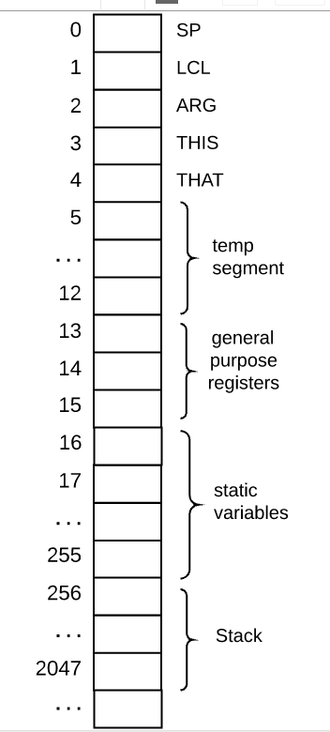
Implementing push/pop static i
RAM
Implementation
The static segment is stored in a fixed RAM block, starting at address 16
When translating a VM file named Foo.vm:
To push/pop static i, generate assembly code that executes
push/pop Foo.i
Explanation:
The Hack assembler will subsequently map every symbol Foo.i in the generated assembly code onto RAM[16], RAM[17], ..., RAM[255]
(exactly what we want…)
Notes:
This is the first time that the mapping is not platform agnostic

Slide 90
Implementing push/pop temp i
Abstraction
stack
8 memory segments
push
0
local
argument
this
that
constant
static
temp
pointer
0
1
pop
1
2
2
...
...
The Big Picture
So far, all the variable kinds that we discussed came from the source code
Sometimes, the compiler needs to add to the generated VM code some additional working variables
Our VM implementation provides 8 such variables, stored in a segment named temp

Slide 91
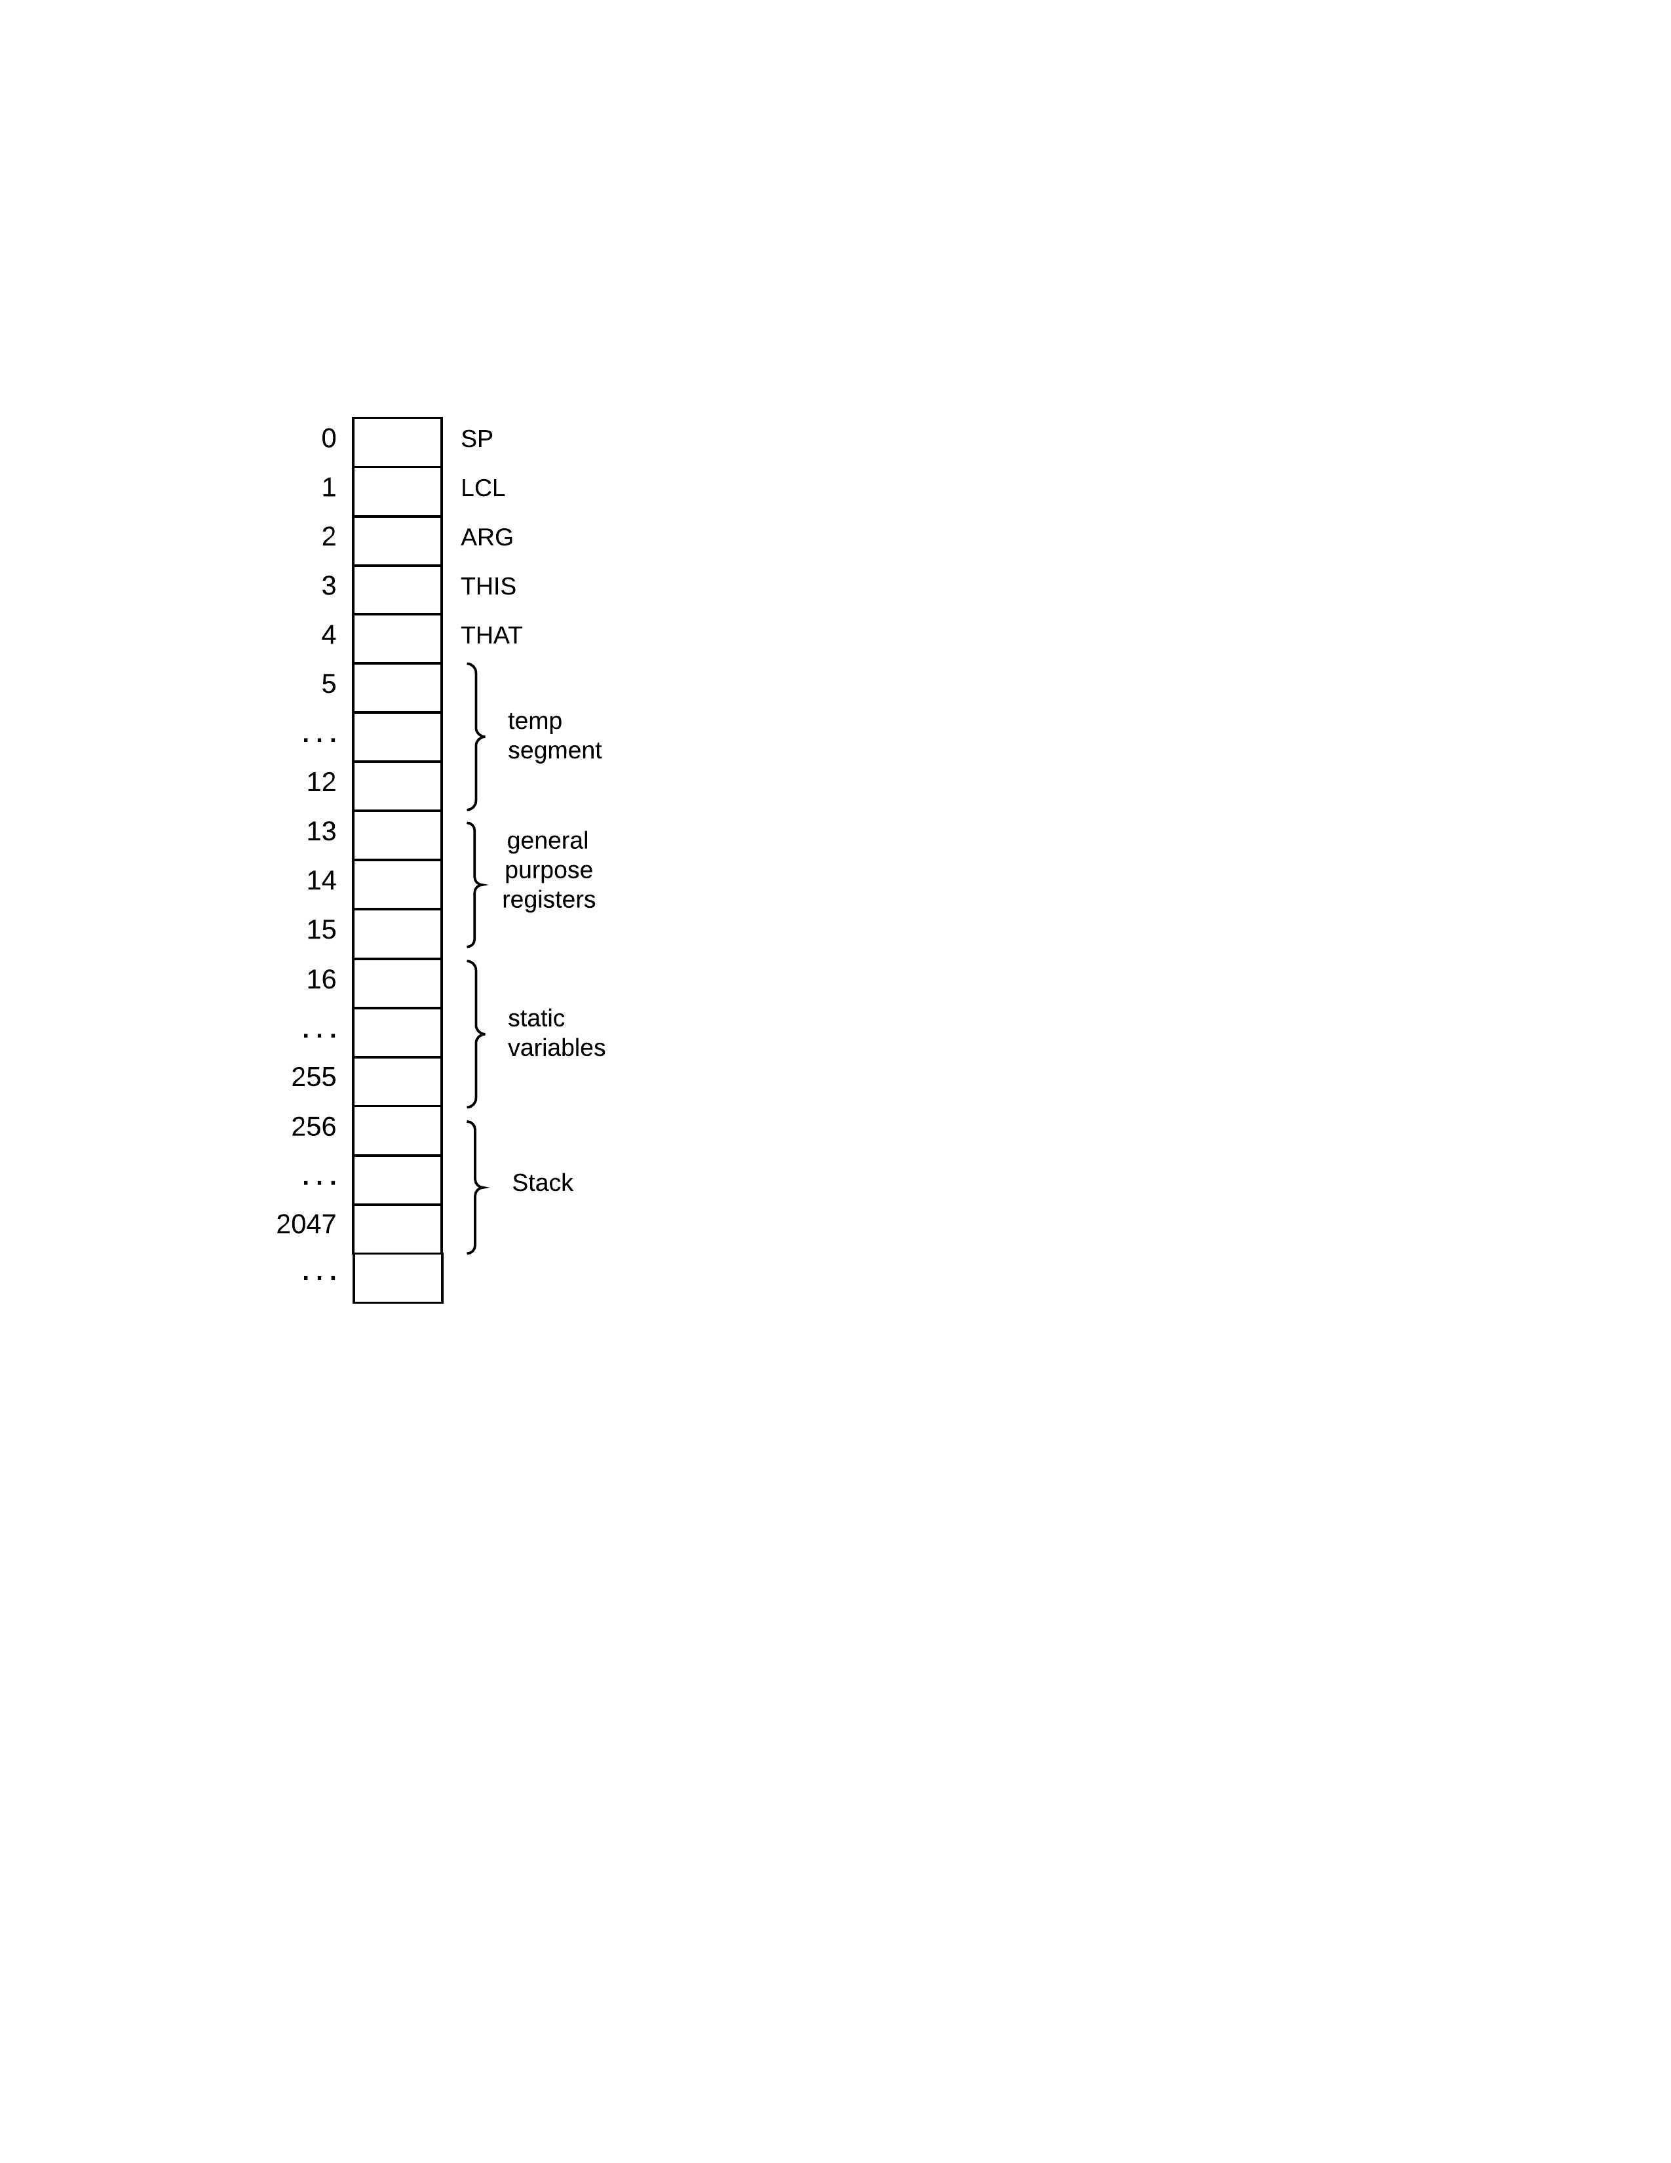
Implementing push/pop temp i
Abstraction
RAM
stack
8 memory segments
push
0
local
argument
this
that
constant
static
temp
pointer
0
1
pop
1
2
2
...
...
Implementation
The temp segment is stored in a fixed RAM block, from address 5 to 12
To push/pop temp i, generate assembly code that executes
push/pop RAM[5 + i]

Slide 92
Implementing push/pop pointer i
Abstraction
RAM
stack
8 memory segments
push
0
local
argument
this
that
constant
static
temp
pointer
0
1
pop
1
2
2
...
...
The big picture
The this and that segments are allocated to the RAM dynamically
Their role will be explained in chapter 10
The compiler uses a 2-place memory segment called pointer for storing the current base addresses of this and that

Slide 93
Implementing push/pop pointer i
Abstraction
RAM
stack
8 memory segments
push
0
local
argument
this
that
constant
static
temp
pointer
0
1
pop
1
2
2
...
...
Implementation
To push/pop pointer 0, generate assembly code that executes
push/pop THIS
To push/pop pointer 1, generate assembly code that executes
push/pop THAT

Slide 94
Implementing push/pop
Abstraction
stack
8 memory segments
push
0
local
argument
this
that
constant
static
temp
pointer
0
1
pop
1
2
2
...
...
Recap: We’ve implemented all the push/pop segment i commands
Note: We’ll discuss the role (semantics) of the VM memory segments later. For now, we focus only on how to handle their syntax.

Slide 95
The VM language: Implementation
Push / pop commands
push segment i
pop segment i
Arithmetic / Logical commands
add, sub , neg
eq , gt , lt
and, or , not
Branching commands
label label
goto label
if-goto label
Function commands
Function functionName nVars
Call functionName nArgs
return

Slide 96
Implementing the arithmetic-logical commands
Command | Return value | Return value
add | x + y | integer
sub | x – y | integer
neg | –y | integer
eq | x == y | boolean
gt | x > y | boolean
lt | x < y | boolean
and | x And y | boolean
or | x Or y | boolean
not | Not x | boolean
Abstraction: Each arithmetic/logical command…
pops one or more values from the stack
Computes a simple function on these values
pushes the computed value onto the stack
Implementation:
We already know how to implement push / pop
The rest is easy.

Slide 97
The VM language: Implementation
Push / pop commands
push segment i
pop segment i
Arithmetic / Logical commands
add, sub , neg
eq , gt , lt
and, or , not
Branching commands
label label
goto label
if-goto label
Function commands
Function functionName nVars
Call functionName nArgs
return
This lecture
Next lecture

Slide 98
Virtual Machine I: Lecture plan
Overview
VM Language: Abstraction
VM Language: Implementation
VM Emulator
Standard Mapping
VM Translator
Project 7
Perspective

Slide 99
VM implementations
software hierarchy
human
abstraction
thought
program
high-level language
abstraction
compiler
VM code
abstraction
OS
VM translator
machine language
The VM abstraction can be implemented in several ways, like:
VM translator: Translates VM commands into the machine language of a target platform
assembler

Slide 100
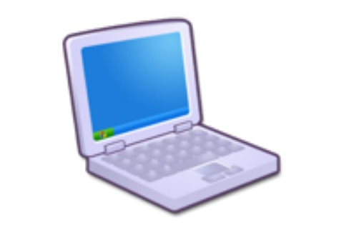
VM implementations
software hierarchy
human
abstraction
thought
program
high-level language
abstraction
compiler
VM code
abstraction
OS
VM translator
machine language
The VM abstraction can be implemented in several ways, like:
VM translator: Translates VM commands into the machine language of a target platform
VM emulator: Uses a high-level language to execute VM commands.
VM emulator
assembler

Slide 101
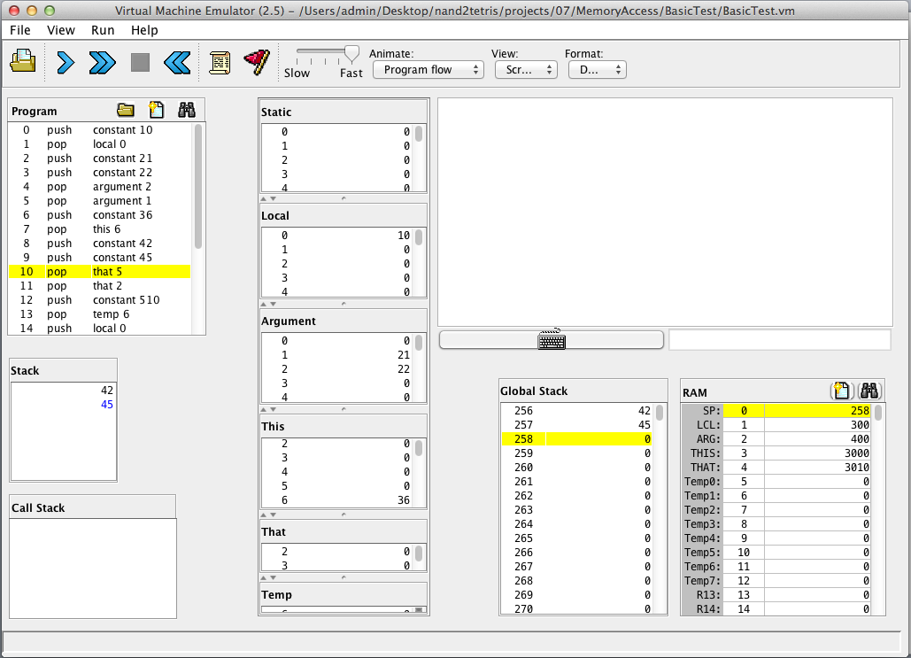

Our VM emulator
execution controls
Multi-purpose pane:
Program output
VM code

Slide 102
Our VM emulator
execution controls
Multi-purpose pane:
Program output
Test script
Output file
Compare file
VM code
stack
memory segments

Slide 103
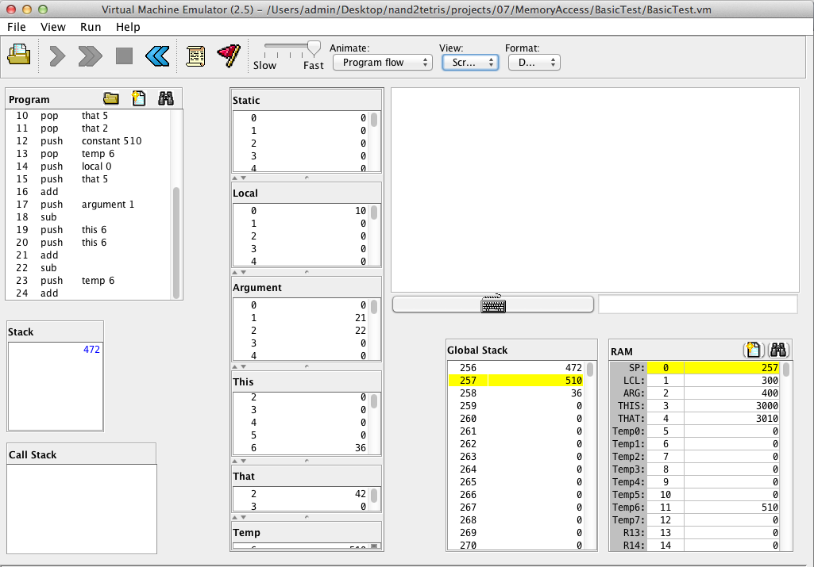
Emulating a VM program: Example
BasicTest.vm
...
push constant 10
pop local 0
push constant 21
push constant 22
pop argument 2
pop argument 1
push constant 36
pop this 6
...
VM code
abstraction
implementation
Stack state
Memory segments states
How the stack and memory segments are realized on the host platform (Hack RAM)
Things to watch for:

Slide 104
Emulating a VM program: Testing
BasicTest.vm
BasicTestVME.tst
...
push constant 10
pop local 0
push constant 21
push constant 22
pop argument 2
pop argument 1
push constant 36
pop this 6
...
load BasicTest.vm,
output-file BasicTest.out,
compare-to BasicTest.cmp,
// Specifies selected values to output, and their format:
output-list RAM[256]%D1.6.1 RAM[300]%D1.6.1 ...
set sp 256, // stack pointer
set local 300, // base address of segment local
set argument 400, // base address of segment argument
set this 3000, // base address of segment this
set that 3010, // base address of segment that
repeat 25 { // BasicTest.vm has 25 VM commands
vmstep;
}
// Outputs the values specified by the output-list
// (stack base + selected values from selected memory segments)
output;
In project 7, we supply test scripts that enable experimenting with the source VM programs in the VM emulator
There is no need to delve into the code details of the supplied test scripts
But, it helps to understand the general testing logic.

Slide 105
Emulating a VM program: Testing
BasicTest.vm
BasicTestVME.tst
...
push constant 10
pop local 0
push constant 21
push constant 22
pop argument 2
pop argument 1
push constant 36
pop this 6
...
load BasicTest.vm,
output-file BasicTest.out,
compare-to BasicTest.cmp,
// Specifies selected values to output, and their format:
output-list RAM[256]%D1.6.1 RAM[300]%D1.6.1 ...
Instructs to output the stack base, and selected values from selected memory segments (as they are stored in the host RAM)
BasicTest.out
BasicTest.cmp
|RAM[256]|RAM[300]|RAM[401]|RAM[402]|RAM[3006|RAM[3012|RAM[3015|RAM[11] |
| 472 | 10 | 21 | 22 | 36 | 42 | 45 | 510 |

Slide 106
Emulating a VM program: Testing
BasicTest.vm
BasicTestVME.tst
...
push constant 10
pop local 0
push constant 21
push constant 22
pop argument 2
pop argument 1
push constant 36
pop this 6
...
load BasicTest.vm,
output-file BasicTest.out,
compare-to BasicTest.cmp,
// Specifies selected values to output, and their format:
output-list RAM[256]%D1.6.1 RAM[300]%D1.6.1 ...
repeat 25 { // BasicTest.vm has 25 VM commands
vmstep;
}
// Outputs the values specified by the output-list
// (stack base + selected values from selected memory segments)
output;
BasicTest.out
BasicTest.cmp
|RAM[256]|RAM[300]|RAM[401]|RAM[402]|RAM[3006|RAM[3012|RAM[3015|RAM[11] |
| 472 | 10 | 21 | 22 | 36 | 42 | 45 | 510 |

Slide 107
Emulating a VM program: Testing
BasicTest.vm
BasicTestVME.tst
...
push constant 10
pop local 0
push constant 21
push constant 22
pop argument 2
pop argument 1
push constant 36
pop this 6
...
load BasicTest.vm,
output-file BasicTest.out,
compare-to BasicTest.cmp,
// Specifies selected values to output, and their format:
output-list RAM[256]%D1.6.1 RAM[300]%D1.6.1 ...
repeat 25 { // BasicTest.vm has 25 VM commands
vmstep;
}
// Outputs the values specified by the output-list
// (stack base + selected values from selected memory segments)
output;
BasicTest.out
The output file and the compare file are identical:
The test is successful
|RAM[256]|RAM[300]|RAM[401]|RAM[402]|RAM[3006|RAM[3012|RAM[3015|RAM[11] |
| 472 | 10 | 21 | 22 | 36 | 42 | 45 | 510 |
BasicTest.cmp
|RAM[256]|RAM[300]|RAM[401]|RAM[402]|RAM[3006|RAM[3012|RAM[3015|RAM[11] |
| 472 | 10 | 21 | 22 | 36 | 42 | 45 | 510 |

Slide 108
Emulating a VM program: Testing
BasicTest.vm
BasicTestVME.tst
function Foo.bar
...
push constant 10
pop local 0
push constant 21
push constant 22
pop argument 2
pop argument 1
push constant 36
pop this 6
...
return
load BasicTest.vm,
output-file BasicTest.out,
compare-to BasicTest.cmp,
// Specifies selected values to output, and their format:
output-list RAM[256]%D1.6.1 RAM[300]%D1.6.1 ...
set sp 256, // stack pointer
set local 300, // base address of segment local
set argument 400, // base address of segment argument
set this 3000, // base address of segment this
set that 3010, // base address of segment that
repeat 25 { // BasicTest.vm has 25 VM commands
vmstep;
}
// Outputs the values specified by the output-list
// (stack base + selected values from selected memory segments)
output;
Normally, VM code begins with function functioName and ends with return
In project 7 though, these commands are not yet implemented. Therefore, the project 7 translator does not allocate memory segments on the host RAM; This will done in project 8
Meanwhile, in project 7 we use test script set commands that cause the VM emulator to anchor the memory segments in fixed (and quite arbitrary) RAM locations.

Slide 109

Demo
VM emulator
demo

Slide 110
Virtual Machine I: Lecture plan
Overview
VM Language: Abstraction
VM Language: Implementation
VM Emulator
Standard Mapping
VM Translator
Project 7
Perspective

Slide 111
The big picture
Source code
Target code
push constant 2
push local 0
sub
push local 1
push constant 5
add
sub
pop local 2
...
// push constant 2
@2
D=A
@SP
A=M
M=D
@SP
M=M+1
// push local 0
...
Translation
Each VM command is translated into several assembly instructions
To write a VM translator, one must be familiar with:
The source language
The target language

Slide 112
The big picture
Source code
Target code
push constant 2
push local 0
sub
push local 1
push constant 5
add
sub
pop local 2
...
// push constant 2
@2
D=A
@SP
A=M
M=D
@SP
M=M+1
// push local 0
...
Translation
Each VM command is translated into several assembly instructions
To write a VM translator, one must be familiar with:
The source language (VM commands)
The target language (Hack assembly language)

Slide 113
The big picture
Source code
Target code
push constant 2
push local 0
sub
push local 1
push constant 5
add
sub
pop local 2
...
// push constant 2
@2
D=A
@SP
A=M
M=D
@SP
M=M+1
// push local 0
...
Translation
Each VM command is translated into several assembly instructions
To write a VM translator, one must be familiar with:
The source language (VM commands)
The target language (Hack assembly language)
How to map the VM stack and memory segments on the target platform in a standard (agreed-upon) way.

Slide 114
Standard VM mapping
The challenge
You propose (to the world) a new VM model / language
Developers can then map the VM’s stack and memory segments on target platforms in several different ways
This can lead to incompatible VM implementations
The solution: Standard VM mapping
Specifies how to map the VM’s stack and memory segments on the target platform in an agreed-upon way

Slide 115
Standard VM mapping
The challenge
You propose (to the world) a new VM model / language
Developers can then map the VM’s stack and memory segments on target platforms in several different ways
This can lead to incompatible VM implementations
The solution: Standard VM mapping
Specifies how to map the VM’s stack and memory segments on the target platform in an agreed-upon way
Benefits: Compatibility with…
Other software systems (VM emulator, OS, …)
Test files
That conform to that standard

Slide 116
Standard VM mapping on the Hack platform
Hack RAM

Slide 117
Standard VM mapping on the Hack platform
Hack RAM
local, argument, this, that: allocated dynamically to the RAM (in project 8). The base addresses of these allocations are kept in the segment pointers LCL, ARG, THIS, THAT
accessing segment i should result in accessing RAM[segmentPointer + i]
constant: accessing constant i should result in supplying the constant i
static: accessing static i within file Foo.vm should result in accessing the assembly variable Foo.i
temp: fixed segment, mapped on RAM addresses 5-12.
accessing temp i should result in accessing RAM[5 + i]
pointer: fixed segment, mapped on RAM addresses 3-4.
accessing pointer 0 should result in accessing THIS accessing pointer 1 should result in accessing THAT

Slide 118
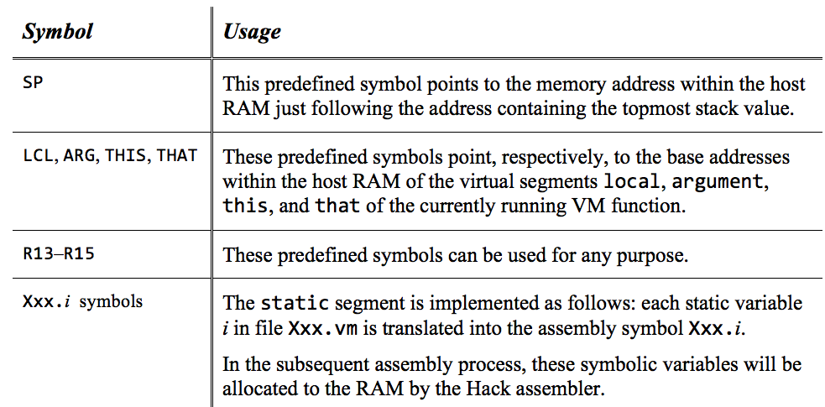
Standard VM mapping on the Hack platform
Hack RAM
The assembly code generated by a VM translator that conforms to the standard mapping should use the following variable symbols:

Slide 119
Virtual Machine I: Lecture plan
Overview
VM Language: Abstraction
VM Language: Implementation
VM Emulator
Standard Mapping
VM Translator
Project 7
Perspective

Slide 120
The Big Picture: Program compilation
“source code”
“abstract code”
“executable code”
Program written in a high-level language
VM commands
(Bytecode)
Machine level instructions
(bits)
compiler
VM translator
Executes in your mind
Executes on an abstract Virtual Machine
Executes on a real computer

Slide 121
The VM translator
VM code ( fileName.vm)
Generated assembly code ( fileName.asm)
...
push constant 17
push local 2
add
pop argument 1
...
VM translator

Slide 122
The VM translator
VM code ( fileName.vm)
Generated assembly code ( fileName.asm)
...
push constant 17
push local 2
add
pop argument 1
...
...
// push constant 17
@17
D=A
... additional assembly code that completes the
implementation of push constant 17
VM translator

Slide 123
The VM translator
VM code ( fileName.vm)
Generated assembly code ( fileName.asm)
...
push constant 17
push local 2
add
pop argument 1
...
...
// push constant 17
@17
D=A
... additional assembly code that completes the
implementation of push constant 17
VM translator

Slide 124
The VM translator
VM code ( fileName.vm)
Generated assembly code ( fileName.asm)
...
push constant 17
push local 2
add
pop argument 1
...
...
// push constant 17
@17
D=A
... additional assembly code that completes the
implementation of push constant 17
// push local 2
... generated assembly code that implements push local 2
VM translator

Slide 125
The VM translator
VM code ( fileName.vm)
Generated assembly code ( fileName.asm)
...
push constant 17
push local 2
add
pop argument 1
...
...
// push constant 17
@17
D=A
... additional assembly code that completes the
implementation of push constant 17
// push local 2
... generated assembly code that implements push local 2
VM translator

Slide 126
The VM translator
VM code ( fileName.vm)
Generated assembly code ( fileName.asm)
...
push constant 17
push local 2
add
pop argument 1
...
...
// push constant 17
@17
D=A
... additional assembly code that completes the
implementation of push constant 17
// push local 2
... generated assembly code that implements push local 2
// add
... generated assembly code that implements add
VM translator

Slide 127
The VM translator
VM code ( fileName.vm)
Generated assembly code ( fileName.asm)
...
push constant 17
push local 2
add
pop argument 1
...
...
// push constant 17
@17
D=A
... additional assembly code that completes the
implementation of push constant 17
// push local 2
... generated assembly code that implements push local 2
// add
... generated assembly code that implements add
VM translator

Slide 128
The VM translator
VM code ( fileName.vm)
Generated assembly code ( fileName.asm)
...
push constant 17
push local 2
add
pop argument 1
...
...
// push constant 17
@17
D=A
... additional assembly code that completes the
implementation of push constant 17
// push local 2
... generated assembly code that implements push local 2
// add
... generated assembly code that implements add
// pop argument 1
... generated assembly code that implements push argument 1
...
VM translator

Slide 129
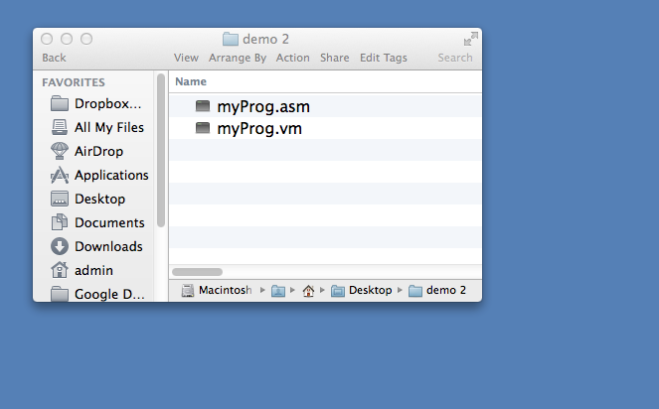
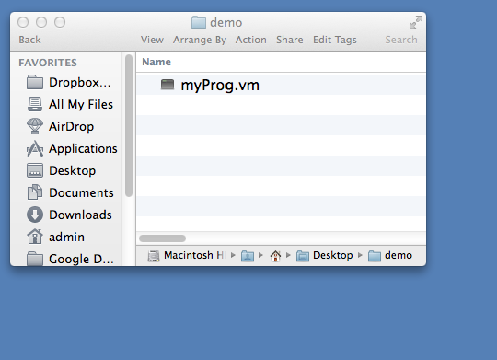
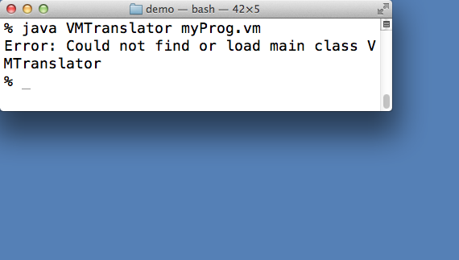
The VM translator: usage
%
% java VMTranslator myProg.vm
%

Slide 130
The VM translator: Implementation notes
Proposed design:
Parser: parses each VM command into its lexical elements
CodeWriter: writes the assembly code that implements the parsed command
Main: drives the process (VMTranslator)
Main (VMTranslator)
Input:
fileName.vm
Output:
fileName.asm
Main logic:
Constructs a Parser to handle the input file
Constructs a CodeWriter to handle the output file
Marches through the input file, parsing each line and generating code from it.

Slide 131
Parser API
Handles the parsing of a single .vm file
Reads a VM command, parses the command into its lexical components, and provides convenient access to these components
Ignores white space and comments

Slide 132
Parser API
Handles the parsing of a single .vm file
Reads a VM command, parses the command into its lexical components, and provides convenient access to these components
Ignores white space and comments

Slide 133
Parser API
Handles the parsing of a single .vm file
Reads a VM command, parses the command into its lexical components, and provides convenient access to these components
Ignores white space and comments

Slide 134
Parser API
Handles the parsing of a single .vm file
Reads a VM command, parses the command into its lexical components, and provides convenient access to these components
Ignores white space and comments

Slide 135
CodeWriter API
Generates assembly code from the parsed VM command:

Slide 136
CodeWriter API
Generates assembly code from the parsed VM command:

Slide 137
CodeWriter API
Generates assembly code from the parsed VM command:

Slide 138
CodeWriter API
Generates assembly code from the parsed VM command:
More routines will be added to this module in Project 8, when we complete the implementation of the VM translator.

Slide 139
Virtual Machine I: Lecture plan
Overview
VM Language: Abstraction
VM Language: Implementation
VM Emulator
Standard Mapping
VM Translator
Project 7
Perspective

Slide 140
Project 7
software hierarchy
human
abstraction
thought
program
high-level language
abstraction
p7
p8
compiler
VM code
Building a
abstraction
OS
VM translator
machine language
Project 7:
Build a basic VM translator that handles the VM
arithmetic-logical and push/pop commands
assembler
Project 8:
Extend the VM translator to handles the VM
branching and function commands.

Slide 141
Project 7
To test the translation:
Run the generated code on the target platform (Hack)
fileName.vm
fileName.asm
...
push constant 17
push local 2
add
pop argument 1
...
...
// push constant 17
@17
D=A
...
// push local 2
... generated assembly code that implements push local 2
// add
... generated assembly code that implements add
// pop argument 1
... generated assembly code that implements push argument 1
...
VM translator
Testing option 1: Translate the generated assembly code into machine language: run the binary code on the Hack computer
Testing option 2 (simpler): Run the generated assembly code on the CPU emulator.

Slide 142
Project 7
Test programs (source)
For each test program xxx.vm we supply 3 test files: xxxVME.tst, xxx.tst and xxx.cmp
SimpleAdd.vm
StackTest.vm
BasicTest.vm
PointerTest.vm
StaticTest.vm
For each test program xxx.vm:
where xxx stands for SimpleAdd, StackTest, BasicTest, PointerTest, StaticTest
0. (optional) Load and run the xxxVME.tst test script in the VM emulator; This will cause the emulator to load and execute xxx.vm; Observe the program’s operation, and how its stack and segments are managed on the host RAM
Use your VM translator to translate xxx.vm; The result will be a file named xxx.asm
Inspect the generated code; If there’s a problem, fix your translator and go to stage 1
Load and run the xxx.tst test script in the CPUemulator, This will cause the emulator to load and execute xxx.asm; Inspect the results
4. If there’s a problem, fix your translator and go to stage 1.
BasicTest.vm (example)
...
push constant 510
pop temp 6
push local 0
push that 5
add
push argument 1
sub
...
BasicTest.asm
...
// push constant 510
@510
D=A
...
Generated by your VM translator

Slide 143
Project 7: Tools and resources
Source, test, compare files: nand2tetris/projects/07
Experimenting with the source VM programs: the supplied VM emulator
Translating the source VM programs into assembly: your VM translator
Testing the resulting assembly code: the supplied CPU emulator
Programming language for implementing your VM translator: Java, Python, ...
Tutorials: VM emulator, CPU emulator (nand2tetris web site)
Reference: chapter 7 in The Elements of Computing Systems

Slide 144
Project 7
Project 7
demo

Slide 145
Virtual Machine I: Lecture plan
Overview
VM Language: Abstraction
VM Language: Implementation
VM Emulator
Standard Mapping
VM Translator
Project 7
Perspective

Slide 146
Perspective
(A subset of historical notes and additional issues)
Brief history of VMs and two-tier compilation:
p-code
Java origins
Cellphones
How close is our VM to Java’s JVM?
Efficiency and optimization
Different VM implementations:
Stack machine
Register machine
Other approaches.
Notes:
Nothing stops a good idea, even if it takes 10 or 100 years
VM is a mission critical program. That’s why efficiency is critical
That’s why VM optimization is important
Stack is not only solution

Slide 147
Recap / Next
Push / pop commands
push segment i
pop segment i
Arithmetic / Logical commands
add, sub , neg
eq , gt , lt
and, or , not
Branching commands
label label
goto label
if-goto label
Function commands
Function functionName nVars
Call functionName nArgs
return
This lecture
Next lecture
Project 7: build a basic VM translator that handles the VM language stack arithmetic and push/pop commands
Project 8: Complete the basic translator into a full-scale VM translator.

Slide 148
Chapter 7
Virtual Machine
(Part I)

